Slide 1
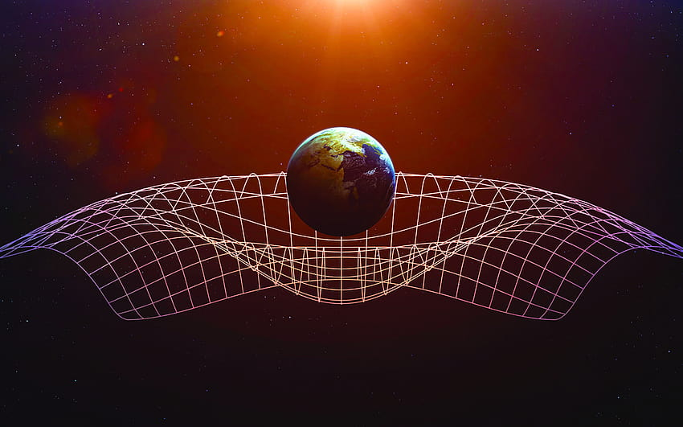
S15641: Relativity Crash Course
July 9, 2023

Slide 2
Welcome!
Athira Arayath
Erick Padilla

Slide 3
Class Logistics
Class time: Sunday 1:05 pm - 2:25 pm
6 classes total : July 9, 2023 - August 13, 2023
Contact us at: S15641-teachers@esp.mit.edu

Slide 4
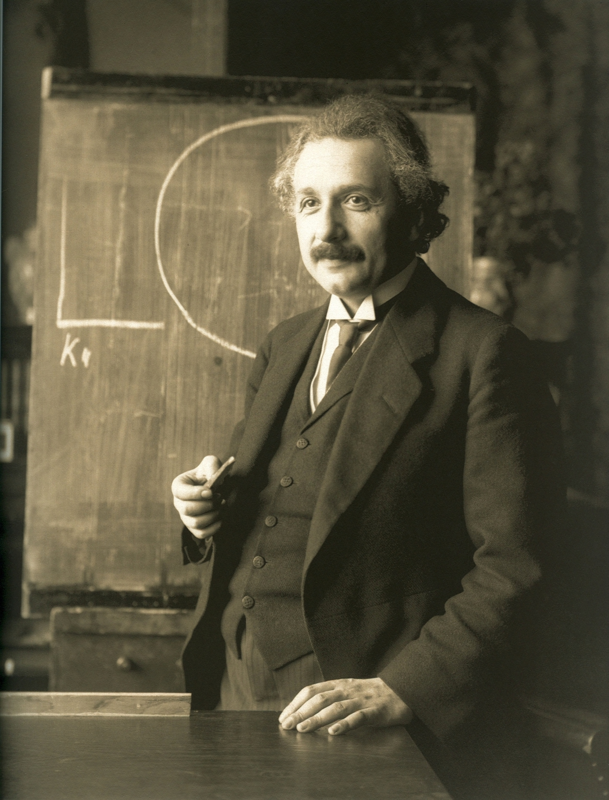
Introduction
What is relativity?
Week 1: The Road to Relativity
Week 02 and 03: Lorentz Transformations
Week 04, 07/30 Spacetime Diagrams
Week 05, 8/6 Energy and Momentum
Week 06, 8/13 General Relativity

Slide 5
Principle of Relativity - Galileo’s Ship

Slide 6
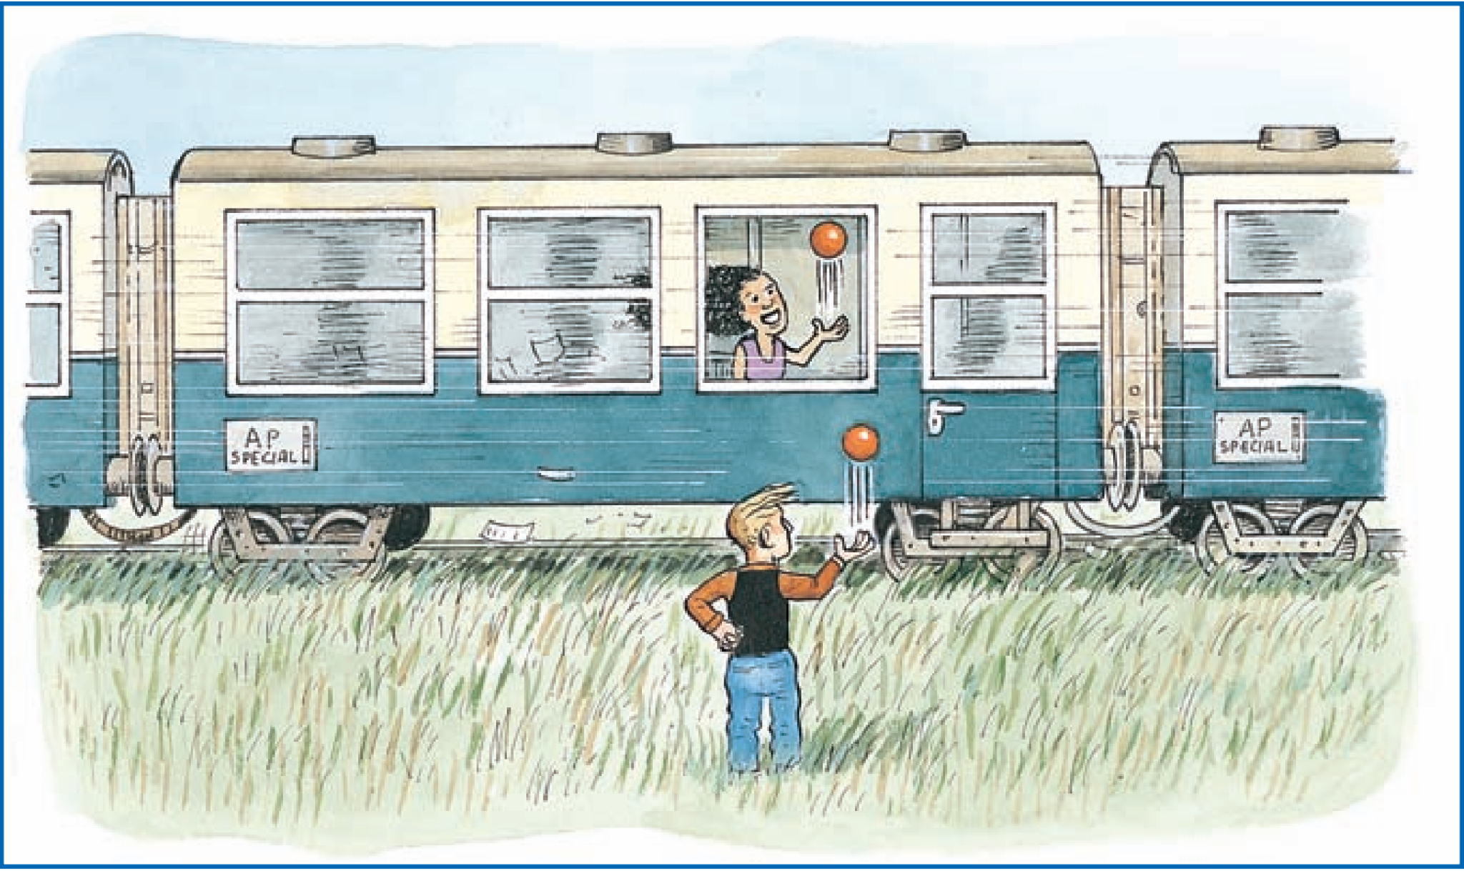
Principle of Relativity (in other words…)
There is no difference between inertial motion and being at rest.

Slide 7
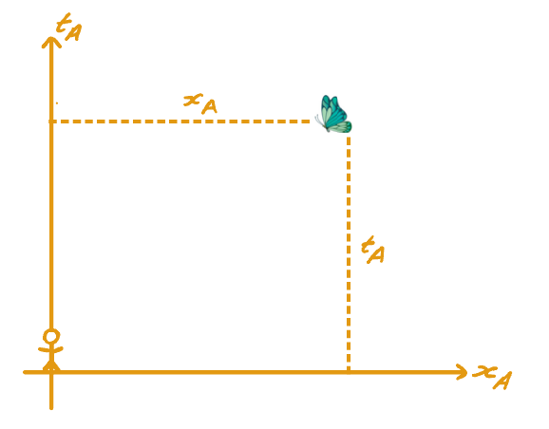
Reference Frames
A reference frame is a coordinate system used by some observer to measures times and distances
The observer sits at the spatial origin of the coordinate system).

Slide 8
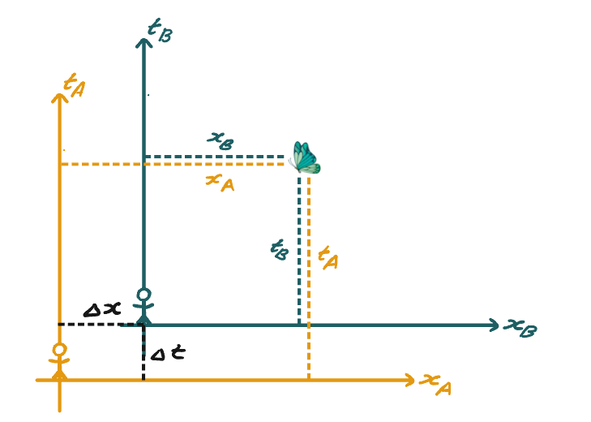
Translated Reference Frames

Slide 9
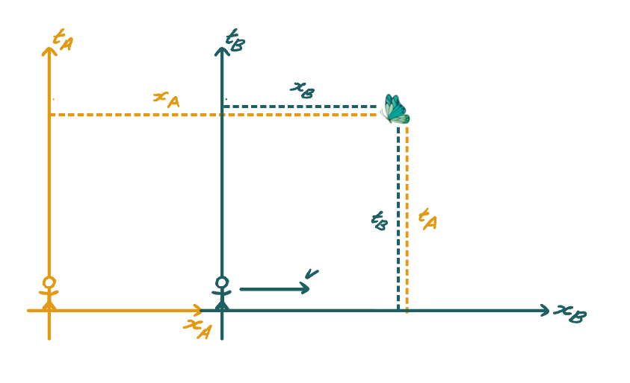
Boosted Reference Frames
An inertial frame is the frame of an observer moving at a constant speed (which can be 0)

Slide 10
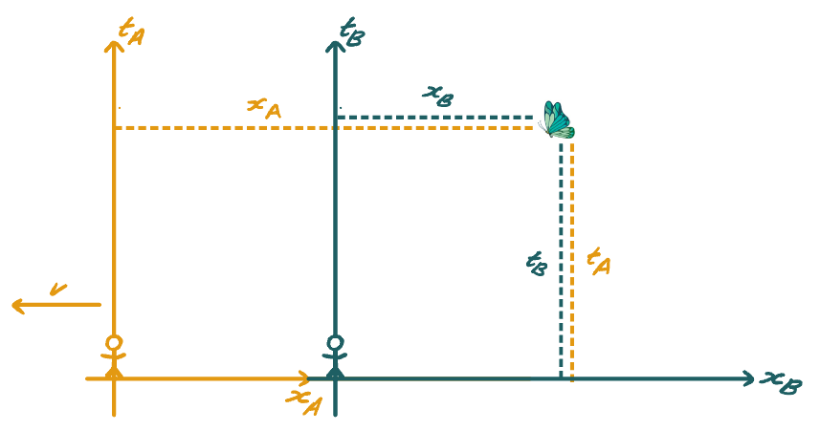
Galilean Transformation
Alice → Bob
Bob → Alice

Slide 11
Velocity
Alice → Bob
Bob → Alice

Slide 12
Acceleration
=> All dynamics are the same in the two reference frames

Slide 13
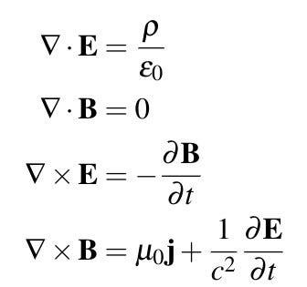
Then Came Electromagnetism
Maxwell compiled 4 equations known as Maxwell’s equations:
These equations predict how moving charges behave.

Slide 14
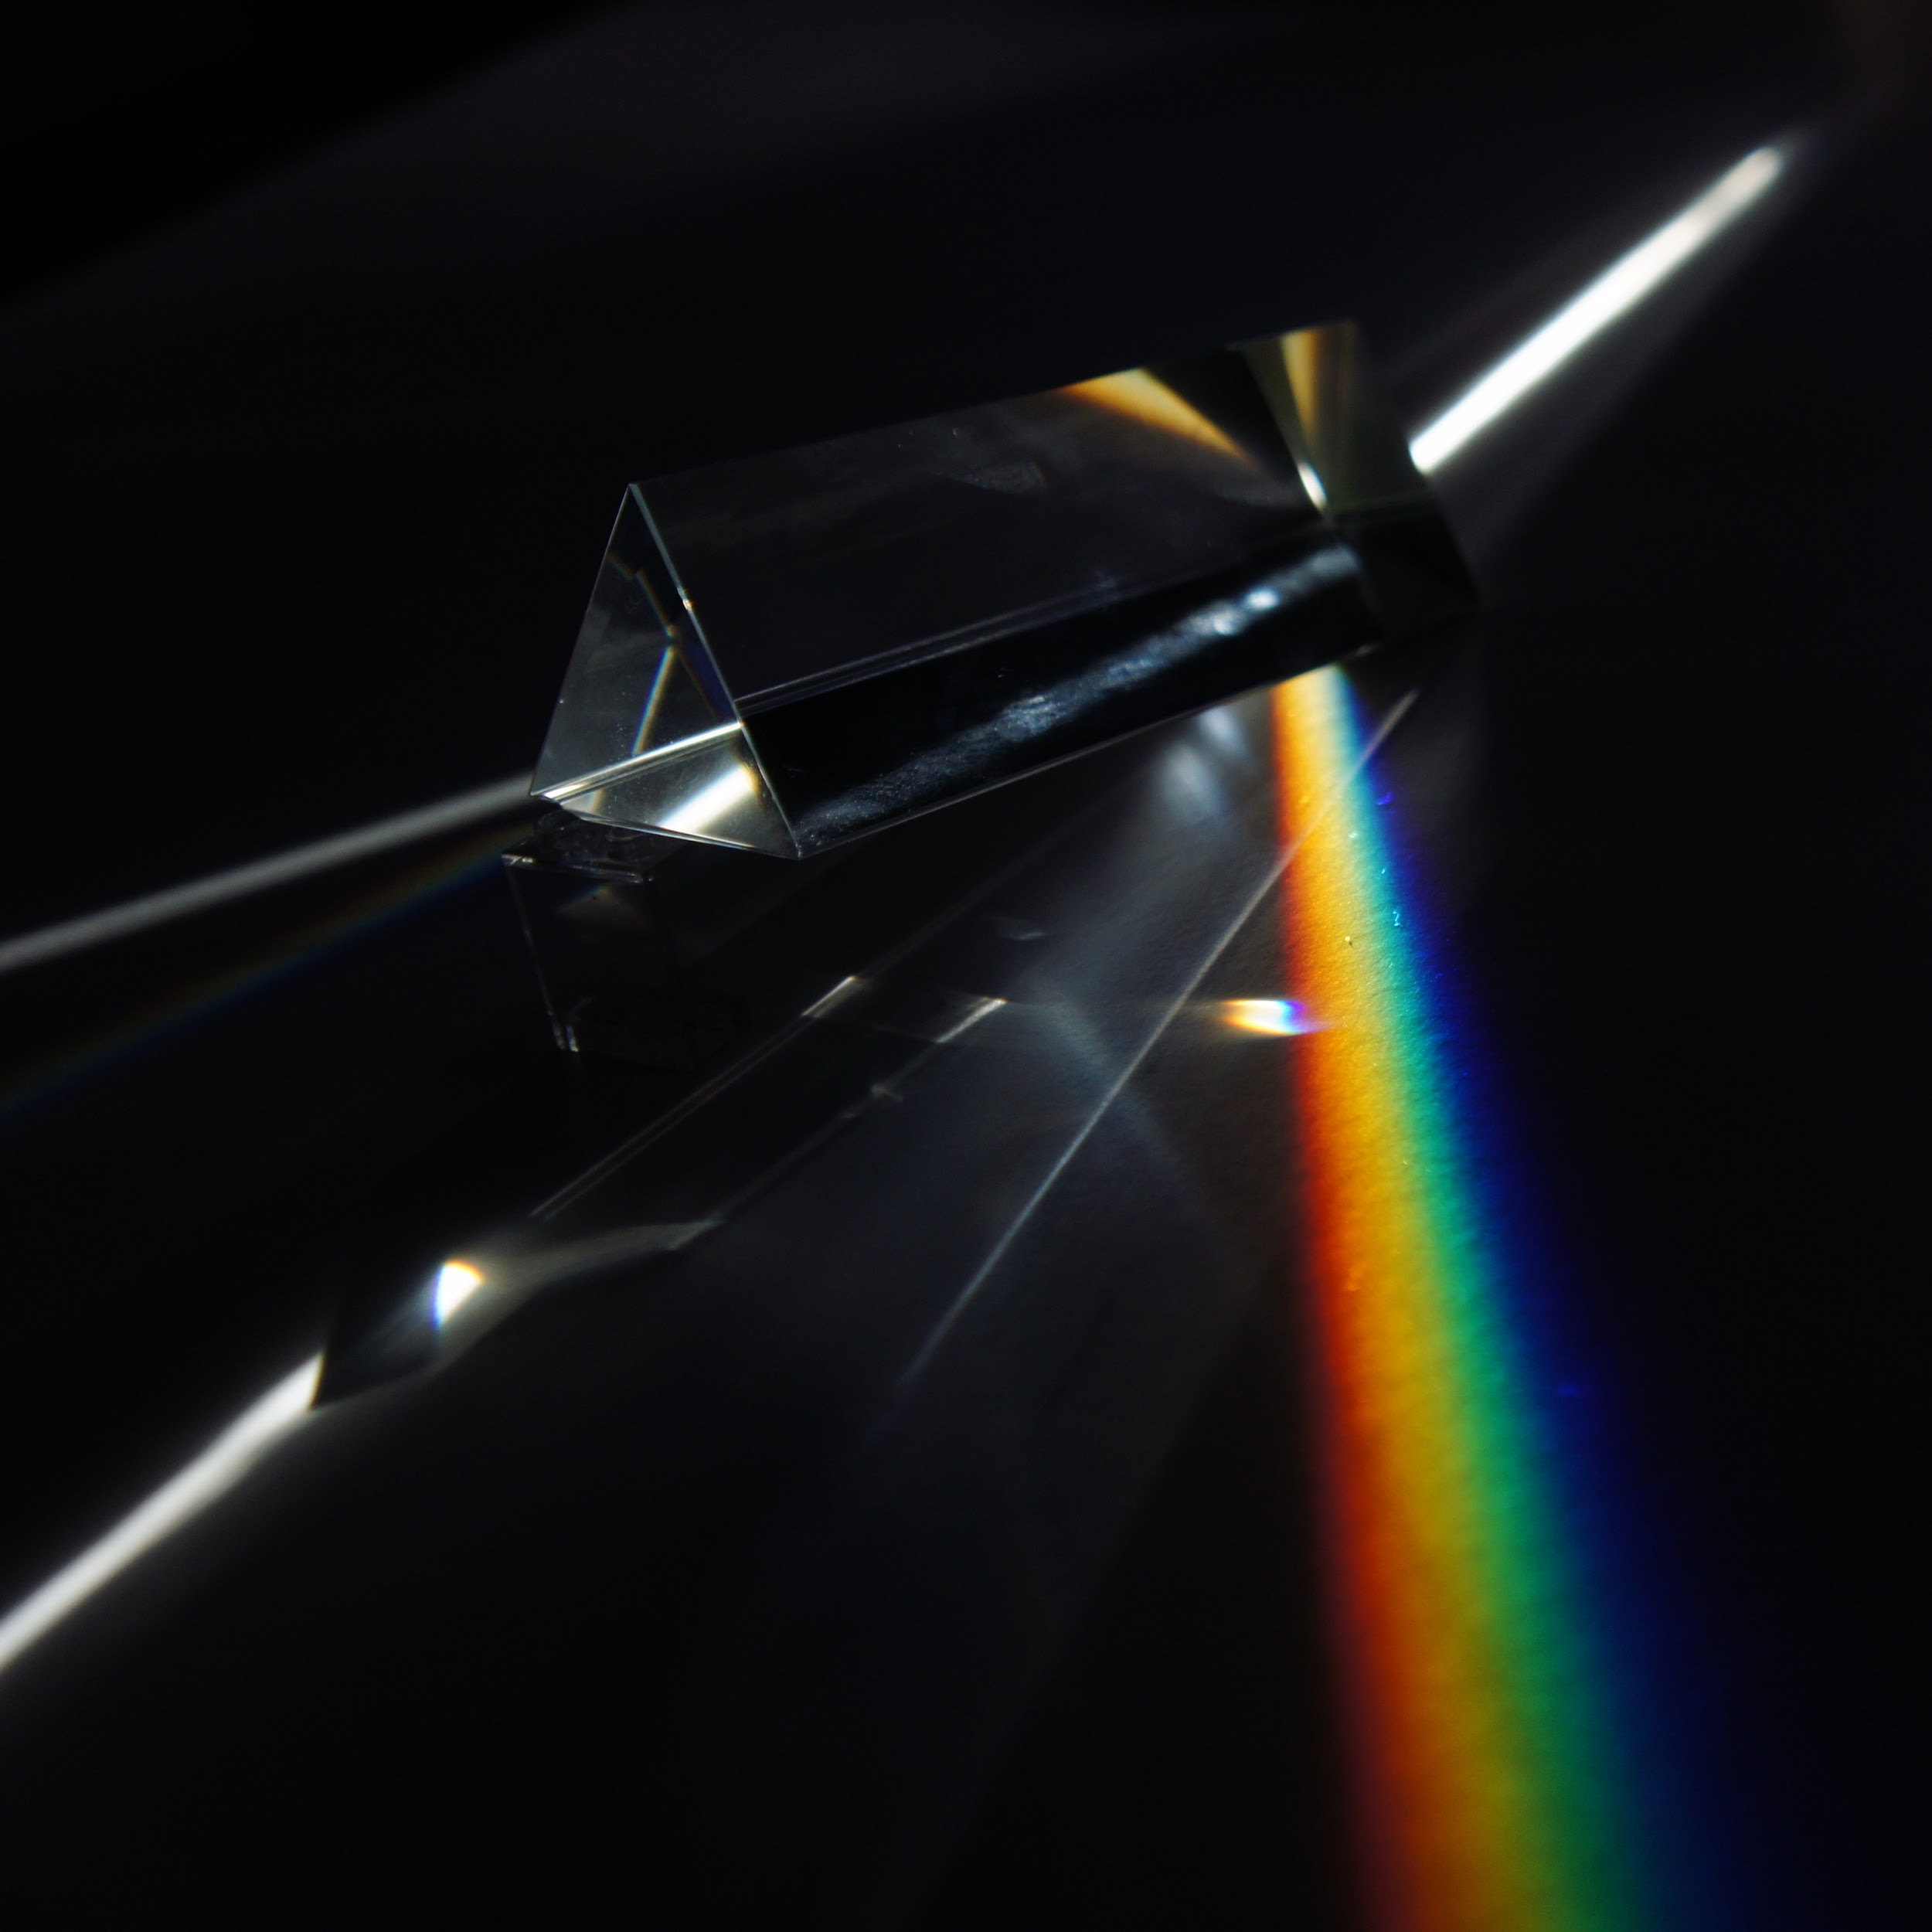
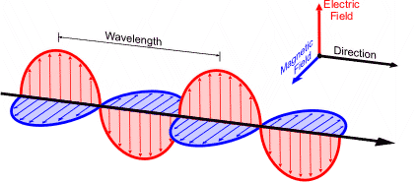
Then Came Electromagnetism
Using these equations, Maxwell found electromagnetic waves moved at a constant speed:
This is the speed of light!

Slide 15
So what’s the problem?
Maxwell’s equations predict the speed of light!
Do you see a problem with this?
In what reference frame is this the speed of light?

Slide 16
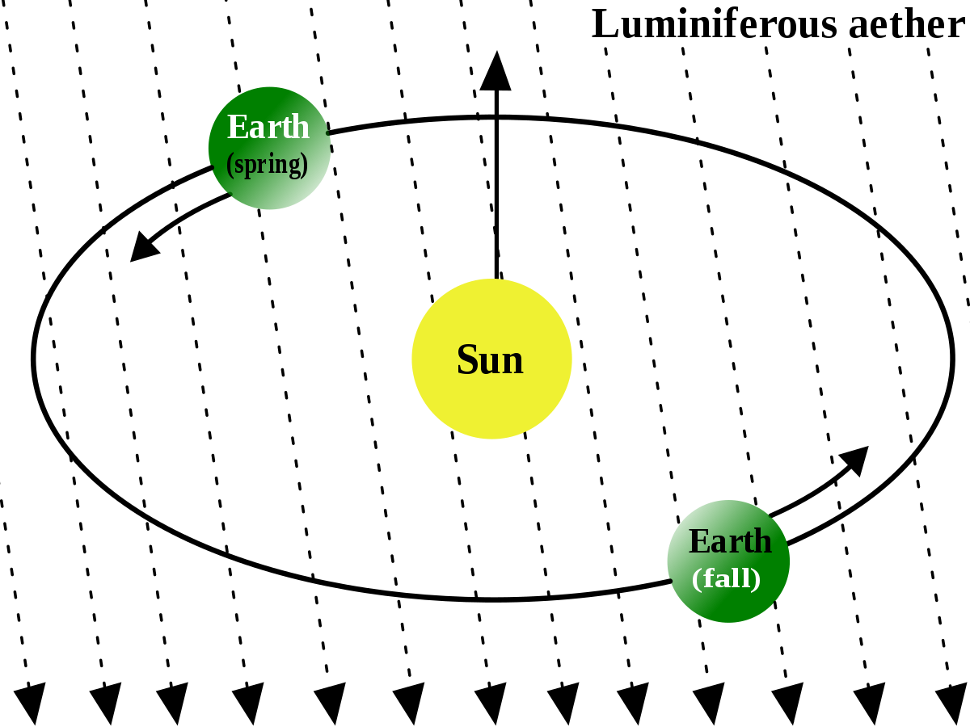
Solution: The Ether
The luminiferous ether was the postulated medium for light.
So the speed of light is c in the ether’s reference frame.

Slide 17
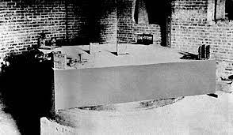
Michelson and Morley
Michelson and Morley designed an experiment to prove the existence of the ether.
They were hoping to calculate the velocity of the earth with respect to the ether.

Slide 18
Michelson and Morley
Branch 1
The velocity of the ether with respect to the Earth can be calculated in terms of the difference in time for the light to travel through Branch 1 vs Branch 2
Branch 2

Slide 19
Michelson and Morley
But they found nothing.
v = 0
Conclusion: the ether doesn’t exist!

Slide 20
The Postulates of Special Relativity
Poll: Which one do we get rid of?
Principle of Relativity
Maxwell’s Equations
Secret third option: Galilean Relativity
Special Relativity
Postulates:
Principle of Relativity
c is constant for all reference frames

Slide 21
Thanks! See you all next week!

